Slide 1
l'opération de surveillance de site industriel

Slide 2
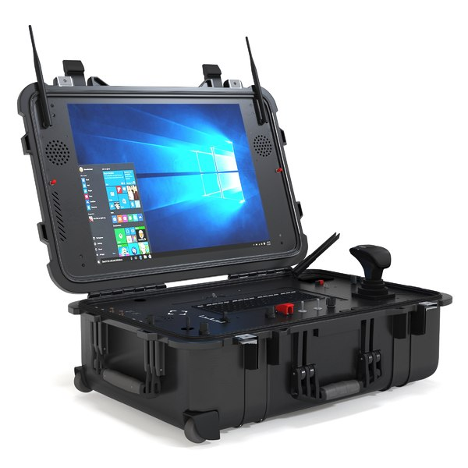
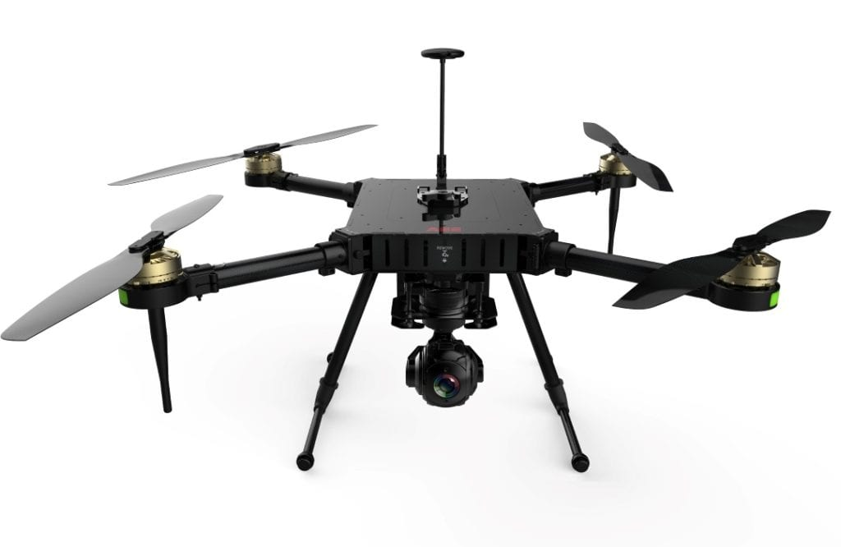
Communication
Ground station
Aircraft

Slide 3
Com 1
(ZOONv3)
Fail-safe
module
Trigger
signal
Parachute
Fail-safe button
UART
Com 1
(ZOONv3)
2.4-2.5Ghz
UART
Fail-safe command
(Mavlink v.2)
Encrypted data
Mavlink v.2
USB/UART
UART
Mavlink v.2
Interrupt
signal
Power board
GCS Computer
(Dell + Linux + Qgroundcontrol*)
Com 2
(ZOONv3)
2.4-2.5Ghz
Com 2
(ZOONv3)
UART
Autopilot
(Pixhawk + Px4*)
USB/UART
Telemetry
(Mavlink v.2)
Encrypted data
Mavlink v.2
I2C
Led
module
PMW
4 X ESCs
Joystick
GPS1
(Ublox- Neo)
GPS antenna 1
UART
UART
GPS2
(TW4721)
GPS
Antenna 2
Video Screen
HDMI
Com 3
(DJI Lightbridge)
2.4 Ghz
Com 3
(DJI Lightbridge)
Gimbal
(Z15 DJI)
Encrypted data
AV
Video camera
Joystick
HDMI
Thermal camera
Ground station
Aircraft

